Slide 1
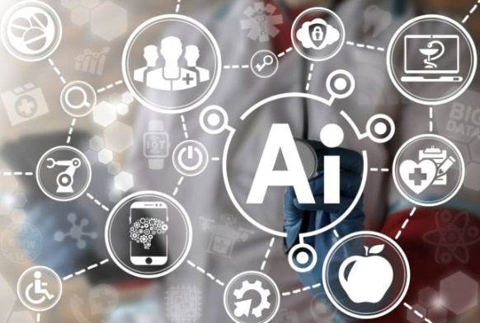
Ethical Development of AI Applications
Prof. Dr-Eng. Eunika Mercier-Laurent
Global Innovation Strategies, IFIP TC12(AI), EPITA, CReSTIC
eunika.mercier-laurent@univ-reims.fr
http://innovation-ecosystems.eu

Slide 2
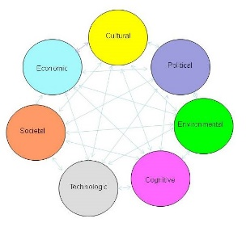
Objectives
Awareness about AI impacts
Understanding various “Ethics”
Critical/Alternative thinking
Knowing AI possibilities
Find the best – greenest- smartest solutions
Use human capacities – brain first

Slide 3


Multiple impacts of AI

Slide 4
Ethics of AI - Content
Ethics: cause to effect graph
“AI for Good”
Treats related to AI?
Importance of Human Factor
Knowledge about what AI can do
Regulation?
Combining data & knowledge
What synergy human-AI?

Slide 5
Ethics?

Slide 6
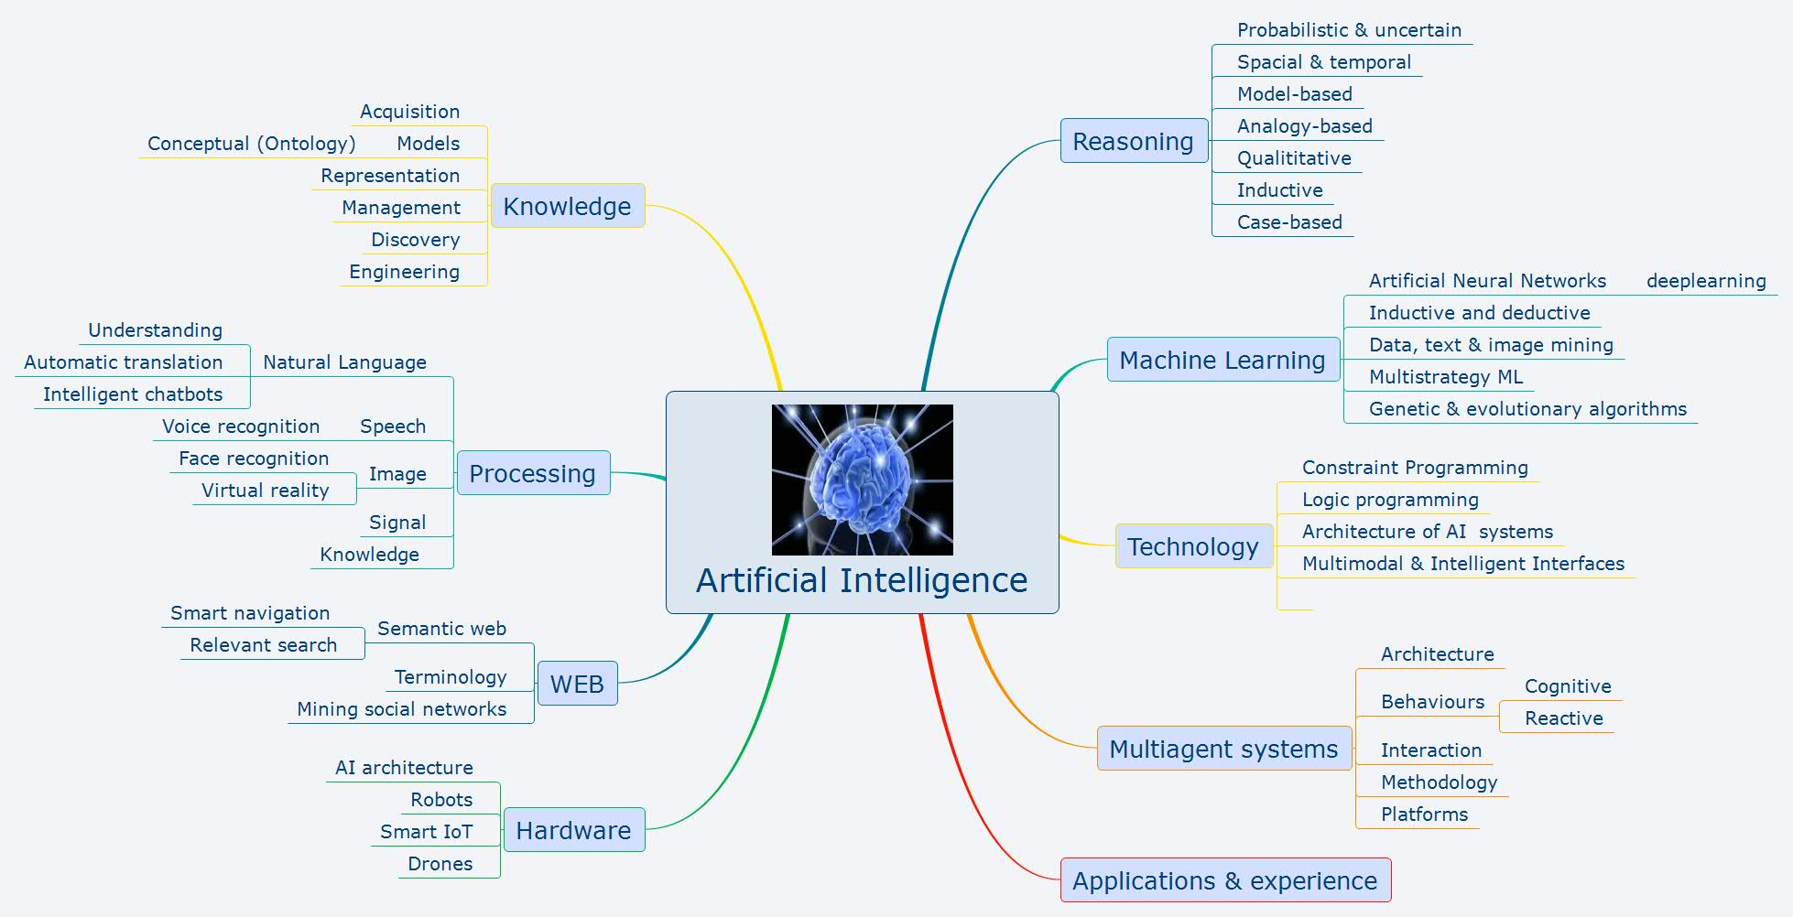
AI today

Slide 7
Ethics (Merriam Webster)
the discipline dealing with what is good and bad and with moral duty and obligation
a set of moral principles : a theory or system of moral values
the principles of conduct governing an individual or a group
a guiding philosophy
a consciousness of moral importance
a set of moral issues or aspects (such as rightness)

Slide 8
AI for Good: When should you trust the developers of AI systems?
https://neuralnetwork.aiforgood.itu.int/event/ai-for-good/auditorium-archive/618bd56f1ca6ce6ae07960c9/timeslot/62bec57f38d0bd79dd659204
July 14, 2022

Slide 9


Focus: 3rd wave of IA
Deep learning for everything
“Intelligent” assistants
Robots, drones, IoT
Autonomous systems
Cybersecurity - https://www.technologyreview.com/2018/08/11/141087/ai-for-cybersecurity-is-a-hot-new-thing-and-a-dangerous-gamble/
Nudges, metaverse…

Slide 10
AI for Marketing Strategy
Marketing’s core activities are understanding customer needs, matching them to products and services, and persuading people to buy—capabilities that AI can dramatically enhance…
https://hbr.org/2021/07/how-to-design-an-ai-marketing-strategy

Slide 11
Warnings and risks
Weak mastering of ML programs - AI is programmed to do something beneficial, but it develops a destructive method for achieving its goal
Bad usages (micro drones, autonomous weapons…)
µdrones https://www.youtube.com/watch?v=TlO2gcs1YvM
Bugs and missing data in autonomous systems

Slide 12
Fired by bot Amazon
https://www.bloomberg.com/news/features/2021-06-28/fired-by-bot-amazon-turns-to-machine-managers-and-workers-are-losing-out?sref=EJ3iffSv

Slide 13
Face recognition and tracking
https://www.youtube.com/watch?v=G1KxMnAERcU 4 min
https://aws.amazon.com/rekognition/?nc1=h_ls
Case: NFL, CBS, Influential, Aella Credit

Slide 14
John MacIntyre – Ethics (AIAI)
https://www.springer.com/journal/43681/editors
Covid tracing – personal, Cambridge analytica, deep fakes,
Who control DB? Who will win the lead in AI? Who will lead the world in 2030?
Coded bias – Shalimi Kantaya? https://hai.stanford.edu/news/coded-bias-director-shalini-kantayya-solving-facial-recognitions-serious-flaws
BMW – code of ethics? https://www.bmwgroup.com/content/dam/grpw/websites/bmwgroup_com/downloads/ENG_PR_CodeOfEthicsForAI_Short.pdf

Slide 15
What is “good AI”?
Robot inventions
https://www.youtube.com/watch?v=OEIeS12TcWU
https://youtu.be/Jky9I1ihAkg
Question:
how much it costs compared to the value of service provided?

Slide 16
Asimov/Campbell – what’s new since 1942?
A robot may not injure a human being or, through inaction, allow a human being to come to harm.
A robot must obey the orders given to it by human beings, except where such orders would conflict with the First Law.
A robot must protect its own existence as long as such protection does not conflict with the First or Second Laws

Slide 17
3 laws of Holo https://www2.dramacool.movie/my-holo-love-episode-1.html min 27-33
I should work for my user’s happiness. If my user does not me to do something I have to stop immediately.
I should comply with laws of my user’s country.
I should not lie to my user.

Slide 18
Some other questions
Can we believe recommendation engines?
Can we predict future by analysis of PAST data? Ex Covid19
What consequence of high frequency trader robots?
https://www.youtube.com/watch?v=5NJCPZmb_RI
https://www.youtube.com/watch?v=NOsE9xCqn5k

Slide 19




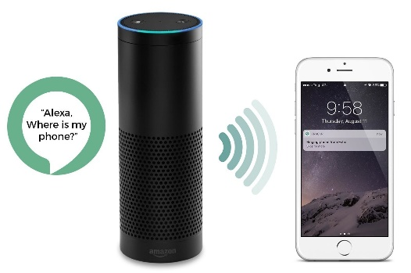
Why people afraid AI?

Slide 20
Why people afraid AI?
Internet, smartphone, IoT & AI – tracking
Service for data
Trust vs fake news & ignorance
Fear
Jobs?
Francis Fukuyama, Michael Crichton

Slide 21
Human Decision making
Madam Secretary
3-5:20, 9:30-13:30, 18:30-23, 28-29, 37-40
SEAL or UGV?

Slide 22
AI Ethics
Group work –
Art of decision making:
What « data » we need? Is it sufficient?
What AI can do?
How to evaluate the consequences before action?
Can AI replace human in such decisions?
Wisdom
Knowledge
Information
Data

Slide 23
Want to buy one?
https://www.globalsecurity.org/military/systems/ground/ugv.htm
What governance?

Slide 24
Don’t look up
Decision making
AI

Slide 25
EU: Trustworthy AI
should be:
(1) lawful - respecting all applicable laws and regulations
(2) ethical - respecting ethical principles and values
(3) robust - both from a technical perspective while taking into account its social environment

Slide 26
EU point of view – 7 requirements
https://www.europarl.europa.eu/RegData/etudes/STUD/2020/634452/EPRS_STU(2020)634452_EN.pdfhttps://ec.europa.eu/digital-single-market/en/news/ethics-guidelines-trustworthy-ai
https://digital-strategy.ec.europa.eu/en/library/ethics-guidelines-trustworthy-ai
1. Human agency and oversight: AI systems should empower human beings, allowing them to make informed decisions and fostering their fundamental rights. At the same time, proper oversight mechanisms need to be ensured, which can be achieved through human-in-the-loop, human-on-the-loop, and human-in-command approaches

Slide 27
7 key requirements (EU)
2. Technical Robustness and safety: AI systems need to be resilient and secure. They need to be safe, ensuring a fall back plan in case something goes wrong, as well as being accurate, reliable and reproducible. That is the only way to ensure that also unintentional harm can be minimized and prevented.
3. Privacy and data governance: besides ensuring full respect for privacy and data protection, adequate data governance mechanisms must also be ensured, taking into account the quality and integrity of the data, and ensuring legitimised access to data.

Slide 28
7 key requirements (EU)
4. Transparency: the data, system and AI business models should be transparent. Traceability mechanisms can help achieving this. Moreover, AI systems and their decisions should be explained in a manner adapted to the stakeholder concerned. Humans need to be aware that they are interacting with an AI system, and must be informed of the system’s capabilities and limitations.
5. Diversity, non-discrimination and fairness: Unfair bias must be avoided, as it could have multiple negative implications, from the marginalization of vulnerable groups, to the exacerbation of prejudice and discrimination. Fostering diversity, AI systems should be accessible to all, regardless of any disability, and involve relevant stakeholders throughout their entire life circle.

Slide 29
7 key requirements (EU)
6. Societal and environmental well-being: AI systems should benefit all human beings, including future generations. It must hence be ensured that they are sustainable and environmentally friendly. Moreover, they should take into account the environment, including other living beings, and their social and societal impact should be carefully considered.
7. Accountability: Mechanisms should be put in place to ensure responsibility and accountability for AI systems and their outcomes. Auditability, which enables the assessment of algorithms, data and design processes plays a key role therein, especially in critical applications. Moreover, adequate an accessible redress should be ensured.

Slide 30
Key requirements
Is it realistic?
From AI point of view
From human point of view
What actions are needed to ensure the respects of this requirements?
What governance?
See also
https://www.linkedin.com/pulse/pour-une-intelligence-artificielle-fiable-s%C3%BBre-et-innovante-breton/

Slide 31
Oxford debate on AI regulation
On WCC 2018, Poznan, Poland
For or against
http://www.wcc2018.org/movs/oxford_debate_rf27.mp4 (1:30)

Slide 32
UNESCO Comest
https://unesdoc.unesco.org/ark:/48223/pf0000381137
Values, principles and Policy Areas
How to evaluate the impacts? (impact assessment)

Slide 33
Investor point of view (Stephen Ibaraki)
File Stephen 5MUX

Slide 34
Lawyer point of view (Anthony Wang)
File KeyNote

Slide 35
AI Ethics and Marketing Strategy
https://www.salesforce.com/blog/responsible-artificial-intelligence-marketing-automation-ethics/

Slide 36
23 Principles to Best Manage AI Stephen Hawking and Elon Musk
https://www.youtube.com/watch?v=juyv4CUMCD0
List https://www.sciencealert.com/experts-have-come-up-with-23-guidelines-to-avoid-an-ai-apocalypse

Slide 37
Discussion
Research
Ethics and values
Long term issues
Each group comments and explains what contribution you can bring at your level

Slide 38
Strategic Intelligence – impacts
https://intelligence.weforum.org/topics/a1Gb0000000pTDREA2?tab=publications

Slide 39
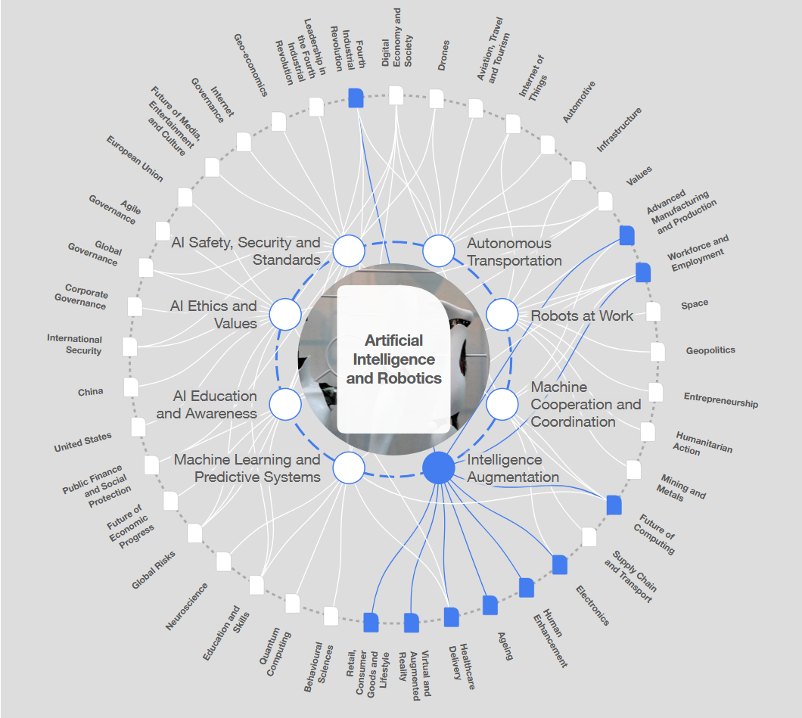

Slide 40
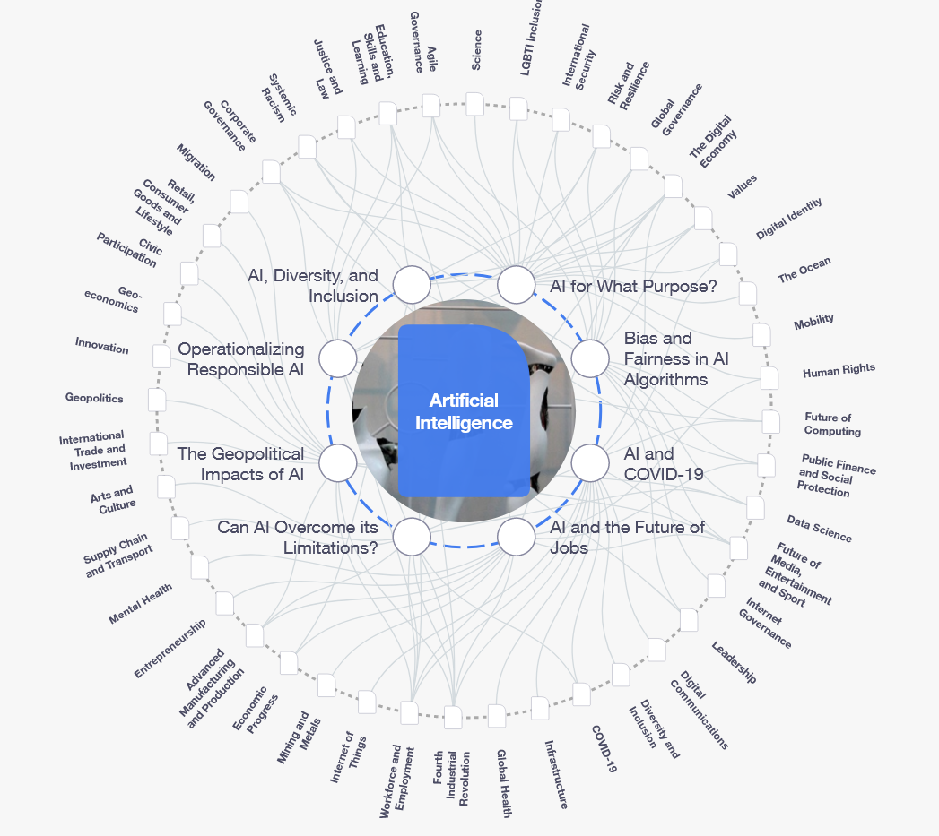

Slide 41
AI Today - Topics to explore and discuss – impacts and connections
Two topics each

Slide 42
AI & human factor
Overconfidence in AI systems -
Automated pilot, UGV, RMI
Loss of know-how
Loss of cognitive capacity
Ex: EDF chatbot

Slide 43
OpenAI (AGI)
https://openai.com/charter/

Slide 44
AI beneficial for humans?
Do we need AGI (Artificial General Intelligence)?
Video Machines playing God: How AI will overcome humans https://www.youtube.com/watch?v=p9eLpRbRk4c
How to change for peaceful https://www.youtube.com/watch?v=LLYPDJTLr4I

Slide 45
Explore & comment
https://www.microsoft.com/en-ca/ai/empowering-innovation
https://aws.amazon.com/machine-learning/ai-services/?nc1=h_ls
https://www.huawei.eu/story/need-ethical-approach-ai

Slide 46
Tay (MS) https://www.youtube.com/watch?v=mtpanIOCRQw in French
https://www.youtube.com/watch?v=HsLup7yy-6I

Slide 47
Issues to consider (WEF)
Unemployment
Inequality. How do we distribute the wealth created by machines?
Humanity. How do machines affect our behavior and interaction?
Artificial stupidity. How can we guard against mistakes?
Racist robots. How do we eliminate AI bias?

Slide 48
Issues to consider (WEF)
Security. How do we keep AI safe from adversaries?
Evil genies. How do we protect against unintended consequences?
Singularity. How do we stay in control of a complex intelligent system?
Robot rights. How do we define the humane treatment of AI?

Slide 49
WEF
http://www3.weforum.org/docs/WEF_Ethics_by_Design_2020.pdf

Slide 50
Some examples of robots – what is really useful?
Microrobots https://www.youtube.com/watch?v=j_Nws3R4fsA
Soldier robot https://www.youtube.com/watch?v=ka0fIAPVjaU
Military https://www.youtube.com/watch?v=176PPn0bQ8Y

Slide 51
Bioinspired
https://www.youtube.com/watch?v=XDeR1JYXSy0
Robodebt https://www.9news.com.au/national/centrelink-robodebt-mothers-who-lost-sons-to-suicide-write-heartbreaking-letters-to-senate/d69bd6fc-2257-4a83-ae77-5c5c6b1384f4

Slide 52
4th generation AI
Data-driven ML
Multisource heterogeneous unstructured data
Explainable, robust and strong AI
Knowledge-based services
Integration
Human knowledge & Kmodels

Slide 53
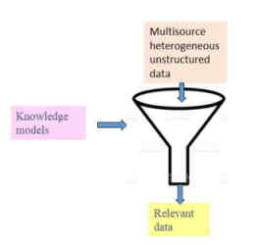

Slide 54

Challenges for AI?

Slide 55
Future AI?
Cognitive AI – intelligent symbolic AI software with bio-inspired, human-like reasoning?
Artificial Subjective Systems? (Michael Zeldich)
Your visions and dreams?

Slide 56
« recipe » for Ethical development of AI applications?

